Slide 1
Cache Oblivious Algorithm
R.Namayandeh
Spring 2015

Slide 2
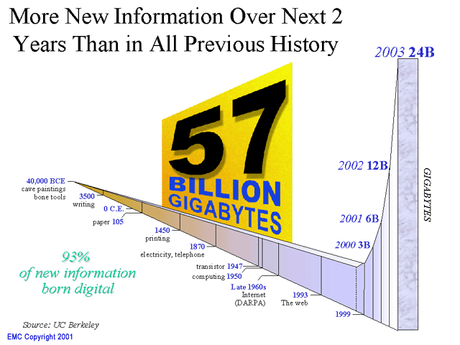
Motivation
Datasets get MASSIVE
example
  Phone: AT&T 20TB phone call database, wireless tracking
  Consumer: WalMart 70TB database, buying patterns
  WEB/Network: Google index 8·10⁹ pages, internet routers
  Geography: NASA satellites generate TB each day

Slide 3
I/O Model
Measure: number of block transfers between two memory levels
Very successful (simplicity)
Limitations
  Parameters B and M must be known
  Does not handle multiple memory levels

Slide 4
Motivation
Computer memories are HIERARCHICAL
R
CPU
L1
L2
L3
A
Disk
M
Increasing
access time
and space
Data moved between adjacent memory level in blocks

Slide 5
Cache-Oblivious Model
The cache-oblivious model is basically the same as the external memory model, but with an important distinction:
  In the cache-oblivious model no knowledge of the sizes of M and B is assumed during algorithm design.
  These parameters are used only during analysis of algorithms.

Slide 6
Cache-Oblivious Model
This simple idea has several surprisingly powerful consequences:
  If a cache-oblivious algorithm performs well between two levels of the memory, then it must automatically work well between any two adjacent levels of the memory hierarchy.
  Typical cache-efficient algorithms require tuning to several cache parameters which are not always available from the manufacturer and often difficult to extract automatically.

Slide 7
Assumption
Optimal page replacement: specifies that the page replacement strategy knows the future and always evicts the page that will be accessed farthest in the future
  Justified: If an algorithm makes T memory transfers on a cache of size M/2 with optimal replacement, then it makes at most 2T memory transfers on a cache of size M with LRU or FIFO replacement (and the same block size B).
Full associativity: it says that any block can be stored anywhere in cache. most caches above the level between main memory and disk have limited associativity meaning that each block belongs to a cluster between 1 and M, usually the block address modulo M, and at most some small constant c of blocks from a common cluster can be stored in cache at once.
Tall-Cache Assumption: It is common to assume that a cache is taller than it is wide, that is, the number of blocks, M/B, is larger than the size of each block, B.

Slide 8

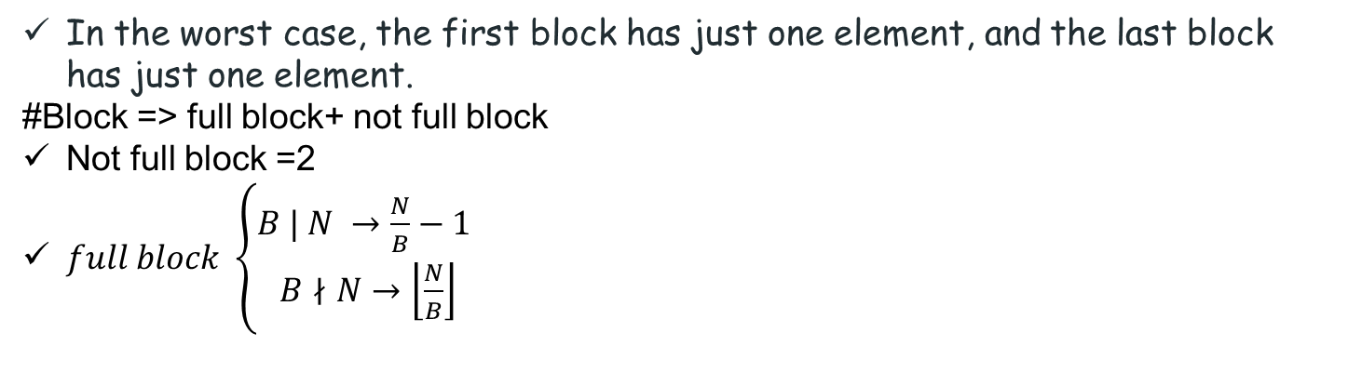
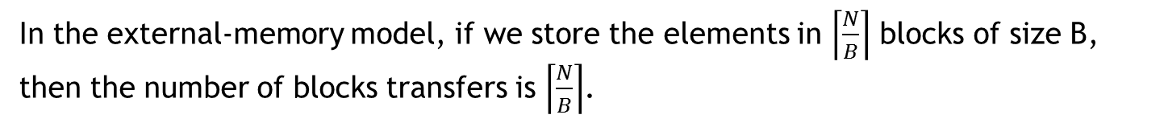
Scanning
Compute
In the external-memory model, if we store the elements in $\left\lceil \frac{N}{B}\right\rceil$ blocks of size B, then the number of blocks transfers is $\left\lceil \frac{N}{B}\right\rceil$.
we can lay out the elements of the set in a contiguous segment of memory, in any order, and implement the N-element traversal by scanning the elements one-by-one in the order they are stored.
In the worst case, the first block has just one element, and the last block has just one element.
#Block => full block+ not full block
Not full block =2
$full block \left\{\begin{aligned}B | N →\frac{N}{B}−1 \\ B∤N→\left\lfloor \frac{N}{B}\right\rfloor \end{aligned}\right.$
#block : $\left\lceil \frac{N}{B}\right\rceil$+1

Slide 9

Matrix Multiplication
Problem: multiplying two $n×n$matrices A and B to produce their $n×n$ product C.
$C_{n×n}=A_{n×n}.B_{n×n}$
How does a matrix can store in Disk?
Row Major
Column Major
Blocked Major

Slide 10
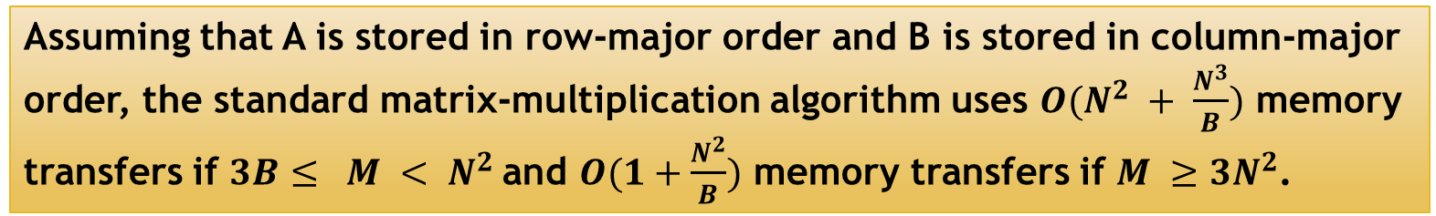
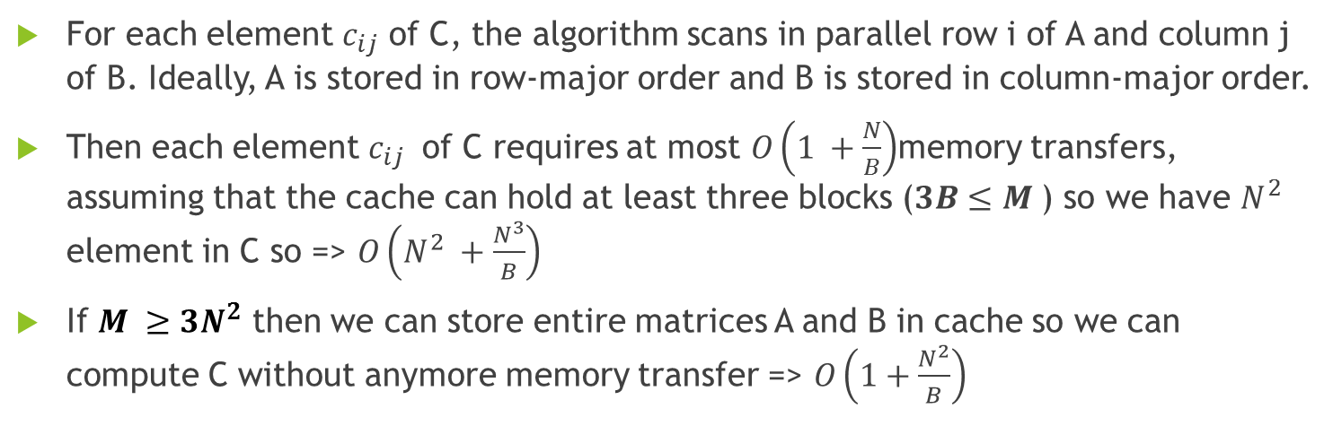
Matrix Multiplication
Assuming that A is stored in row-major order and B is stored in column-major order, the standard matrix-multiplication algorithm uses $O(N^{2} + \frac{N^{3}}{B})$ memory transfers if $3B≤ M < N^{2}$and $O(1+\frac{N^{2}}{B})$ memory transfers if $M ≥3N^{2}$.
For each element $c_{ij}$ of C, the algorithm scans in parallel row i of A and column j of B. Ideally, A is stored in row-major order and B is stored in column-major order.
Then each element $c_{ij}$ of C requires at most $O\left(1 +\frac{N}{B}\right)$memory transfers, assuming that the cache can hold at least three blocks ($3B≤M$) so we have $N^{2}$ element in C so => $O\left(N^{2} +\frac{N^{3}}{B}\right)$
If $M ≥3N^{2}$ then we can store entire matrices A and B in cache so we can compute C without anymore memory transfer => $O\left(1+\frac{N^{2}}{B}\right)$

Slide 11

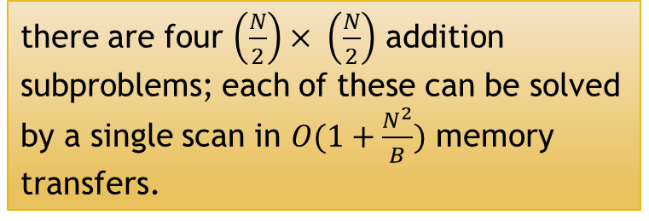
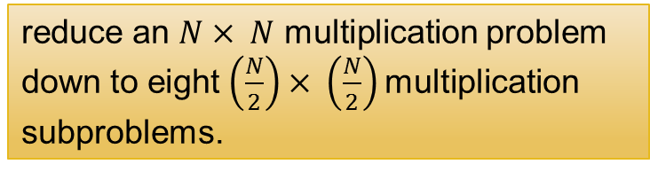
Matrix Multiplication
We can write a matrix multiplication $C = A × B$as a divide-and-conquer recursion using block-matrix notation:
Thus we obtain the following recurrence:
The base of Recursion?
reduce an $N× N$ multiplication problem down to eight $\left(\frac{N}{2}\right)× \left(\frac{N}{2}\right)$multiplication subproblems.
there are four $\left(\frac{N}{2}\right)× \left(\frac{N}{2}\right)$ addition subproblems; each of these can be solved by a single scan in $O(1+\frac{N^{2}}{B})$ memory transfers.

Slide 12
Matrix Multiplication
The base case becomes trickier for this problem, because now both B and M are relevant.
Base of recurrence
B
$$T\left(O\left(\sqrt{B}\right)\right)=O(1)$$
𝑇(𝑂(√𝐵))=𝑂(1)
M
$T\left(O\left(c\sqrt{M}\right)\right)=O\left(\frac{M}{B}\right)$
𝑇(𝑂(𝑐√𝑀))=𝑂(𝑀/𝐵)

Slide 13

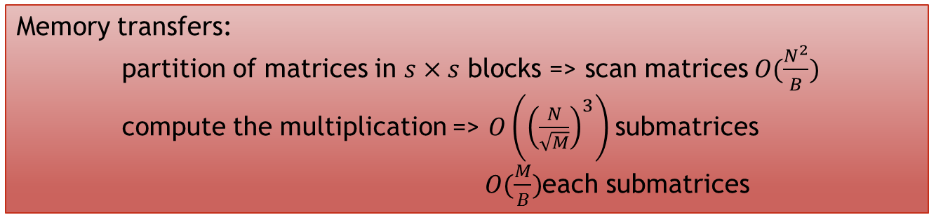
Matrix Multiplication
Memory transfers:
partition of matrices in $s×s$ blocks => scan matrices $O(\frac{N^{2}}{B})$
compute the multiplication => $O\left({\left(\frac{N}{\sqrt{M}}\right)}^{3}\right)$submatrices
$O(\frac{M}{B})$each submatrices
It is an external model algorithm
$$O(\frac{N^{3}}{B\sqrt{M}})$$

Slide 14



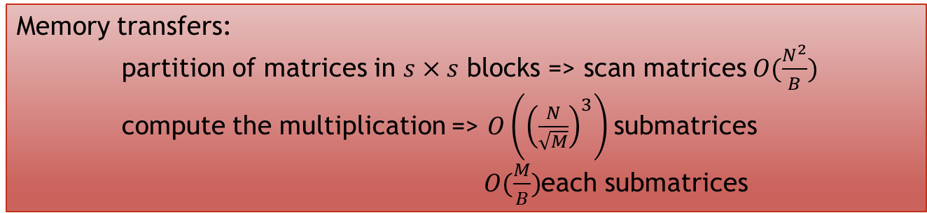
Matrix Multiplication
Main algorithm
$s=O\left(\sqrt{M}\right)$
Partition matrix into $s×s$ blocks
Apply algorithm1 to $\frac{N}{s}×\frac{N}{s}$matrices where elements are $s×s$ matrices.
Algorithm 1
for i = 1 to N
for j = 1 to N
$z_{ij}$ = 0
for k = 1 to N
$z_{ij} = z_{ij}+x_{ik}.y_{kj}$
It is an external model algorithm
Memory transfers:
partition of matrices in $s×s$ blocks => scan matrices $O(\frac{N^{2}}{B})$
compute the multiplication => $O\left({\left(\frac{N}{\sqrt{M}}\right)}^{3}\right)$submatrices
$O(\frac{M}{B})$each submatrices
$$O(\frac{N^{3}}{B\sqrt{M}})$$

Slide 15
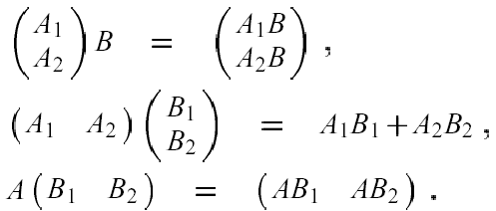

Matrix Multiplication
Partition matrix A and B by half in the largest dimension. $A: n ×m$, $B: m × p$
Proceed recursively until reach the base case-one element.
n ≥ max (m, p)
m ≥ max (n, p)
p ≥ max (n, m)

Slide 16
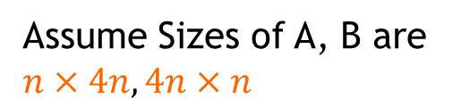
Matrix Multiplication
Assume Sizes of A, B are $n×4n, 4n×n$
A*B
+
A1*B1
A2*B2
+
+
A11*B11
A12*B12
A21*B21
A22*B22

Slide 17
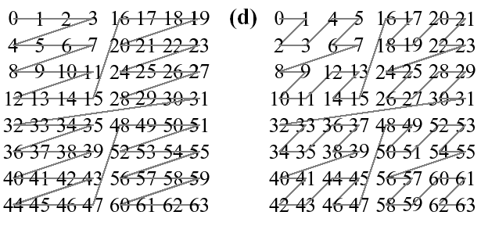
Matrix Multiplication
Intuitively, once a sub problem fits into the cache, its smaller sub problems can be solved in cache with no further misses.

Slide 18
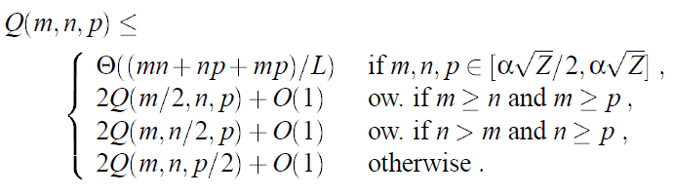
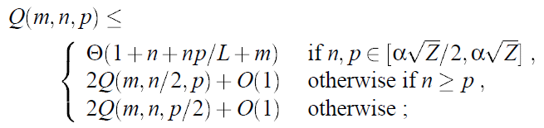
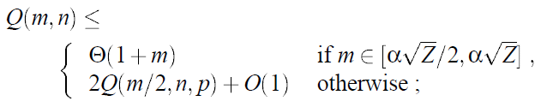
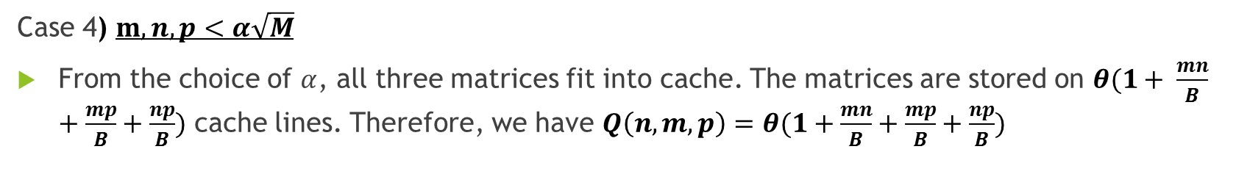
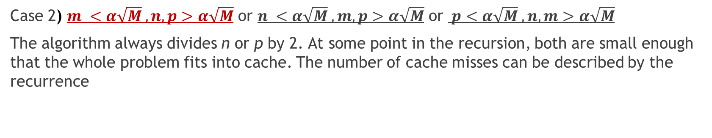
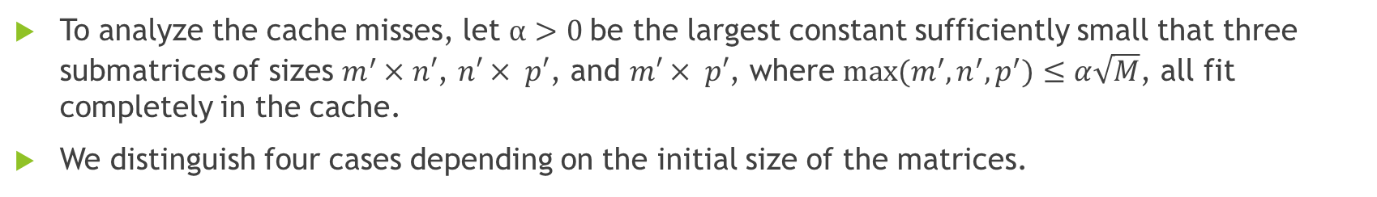
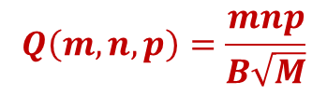
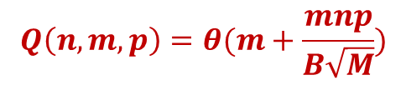
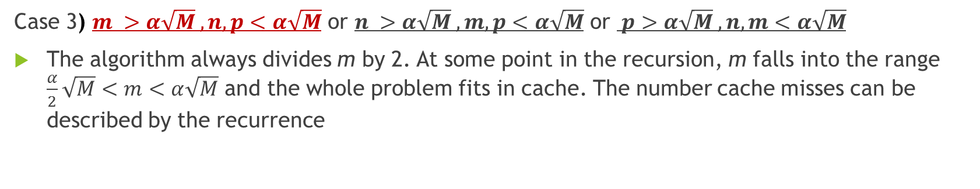
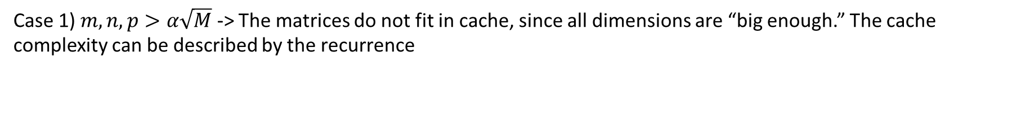
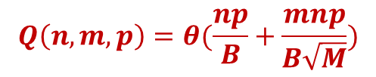
Matrix Multiplication
The Algorithm uses $θ\left(nmp\right)$ work complexity and incurs $θ(m+n+p+\frac{mn+mp+np}{B}+\frac{mnp}{B\sqrt{M}})$ cache misses when multiplying an $m×n$ matrix by $n×p$ matrix.
To analyze the cache misses, let $α>0$be the largest constant sufficiently small that three submatrices of sizes $m^{′}×n′$, $n′× p′$, and $m′× p′$, where $max⁡(m^{′},n^{′},p^{′})≤α\sqrt{M}$, all fit completely in the cache.
We distinguish four cases depending on the initial size of the matrices.
Case 3) $m >α\sqrt{M} , n,p<α\sqrt{M}$ or $n >α\sqrt{M} , m,p<α\sqrt{M}$ or $p>α\sqrt{M} , n,m<α\sqrt{M}$
The algorithm always divides m by 2. At some point in the recursion, m falls into the range $\frac{α}{2}\sqrt{M}<m<α\sqrt{M}$ and the whole problem fits in cache. The number cache misses can be described by the recurrence
Case 4) $m,n,p<α\sqrt{M}$
From the choice of $α$, all three matrices fit into cache. The matrices are stored on $θ(1+ \frac{mn}{B}+\frac{mp}{B}+\frac{np}{B})$ cache lines. Therefore, we have $Q\left(n,m,p\right)=θ(1+\frac{mn}{B}+\frac{mp}{B}+\frac{np}{B})$
Case 2) $m <α\sqrt{M} , n,p>α\sqrt{M}$ or $n <α\sqrt{M} , m,p>α\sqrt{M}$ or $p<α\sqrt{M} , n,m>α\sqrt{M}$
The algorithm always divides n or p by 2. At some point in the recursion, both are small enough that the whole problem fits into cache. The number of cache misses can be described by the recurrence
Case 1) $m,n,p>α\sqrt{M}$ -> The matrices do not fit in cache, since all dimensions are “big enough.” The cache complexity can be described by the recurrence
$$Q\left(m,n,p\right)=\frac{mnp}{B\sqrt{M}}$$
$$Q\left(n,m,p\right)=θ(\frac{np}{B}+\frac{mnp}{B\sqrt{M}})$$
$$Q\left(n,m,p\right)=θ(m+\frac{mnp}{B\sqrt{M}})$$

Slide 19
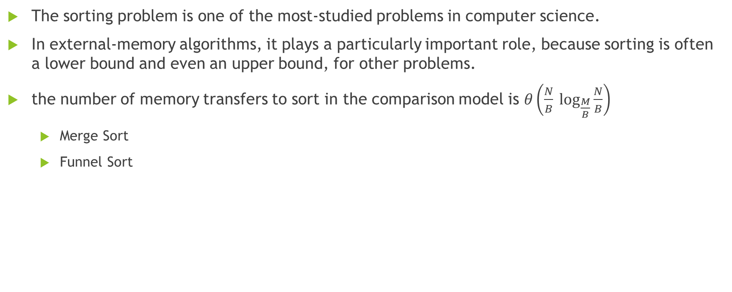
Sorting
The sorting problem is one of the most-studied problems in computer science.
In external-memory algorithms, it plays a particularly important role, because sorting is often a lower bound and even an upper bound, for other problems.
the number of memory transfers to sort in the comparison model is $θ\left(\frac{N}{B} \log_{\frac{M}{B}}{\frac{N}{B}}\right)$
  Merge Sort
  Funnel Sort

Slide 20

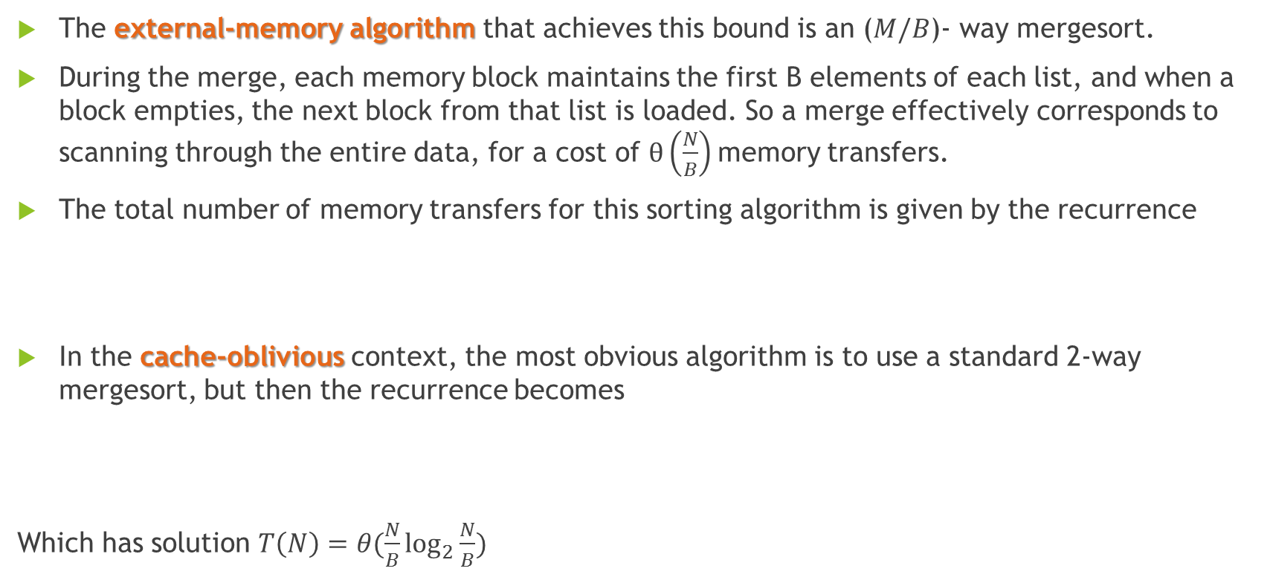
Merge Sort
The external-memory algorithm that achieves this bound is an ($M/B$)- way mergesort.
During the merge, each memory block maintains the first B elements of each list, and when a block empties, the next block from that list is loaded. So a merge effectively corresponds to scanning through the entire data, for a cost of $θ\left(\frac{N}{B}\right)$memory transfers.
The total number of memory transfers for this sorting algorithm is given by the recurrence
In the cache-oblivious context, the most obvious algorithm is to use a standard 2-way mergesort, but then the recurrence becomes
Which has solution $T\left(N\right)=θ(\frac{N}{B}\log_{2}{\frac{N}{B}})$

Slide 21
K-funnel (k-merger)

Slide 22
Funnel Sort
Divide input in K=N ^{1/3} segments of size N ^{2/3}
Recursively FunnelSort each segment
Merge sorted segments by an N ^{1/3}-merger

Slide 23
references
Cache oblivious algorithms and data structures
  Lecture notes by Erik D. Demaine.
Cache-Oblivious Algorithms
  by Matteo Frigo, Charles E. Leiserson, Harald Prokop, and Sridhar Ramachandran. In the 40th Annual Symposium on Foundations of Computer Science, FOCS '99, 17-18 October, 1999, New York, NY, USA.
Presentation “ The Study of Cache Oblivious Algorithms” by Jia Guo
Presentation “External-Memory and Cache-Oblivious Algorithms: Theory and Experiments” by Gerth Stølting Brodal
Presentation “lecture12: Massive Data Algorithmics”

